Slide 1
Glider Designs
Ryan Block, Zach Lesan, Cole MacPherson, Scott Mansfield, Ankrit Uprety

Slide 2
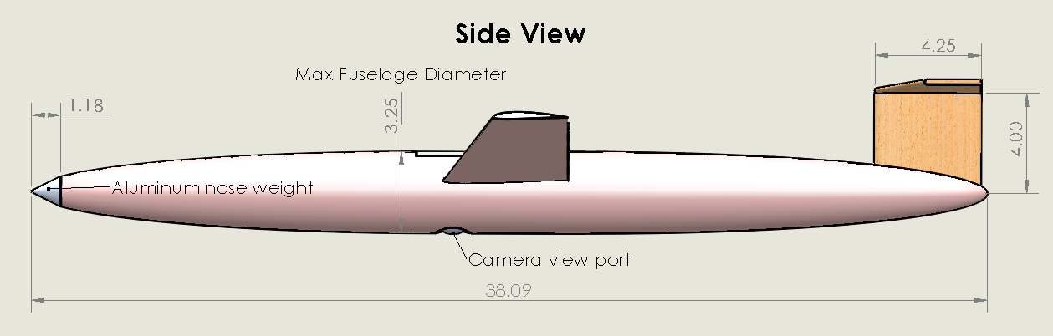
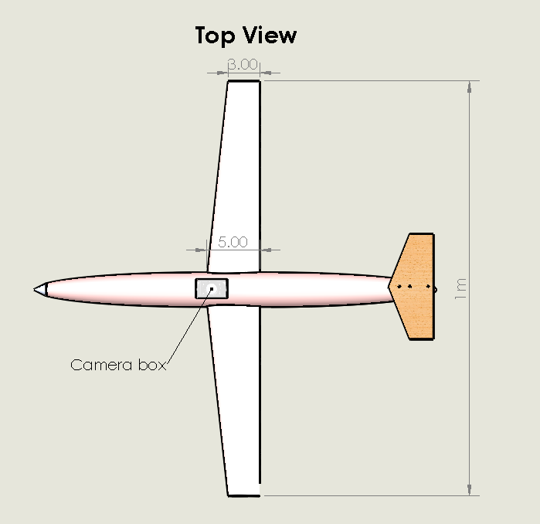
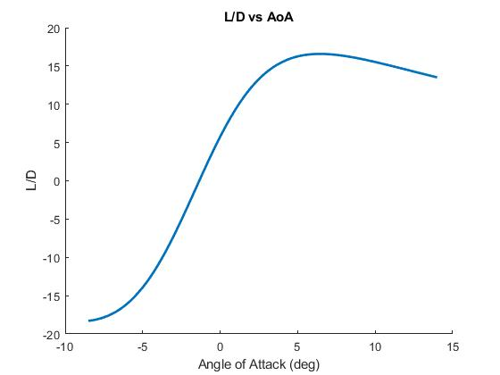
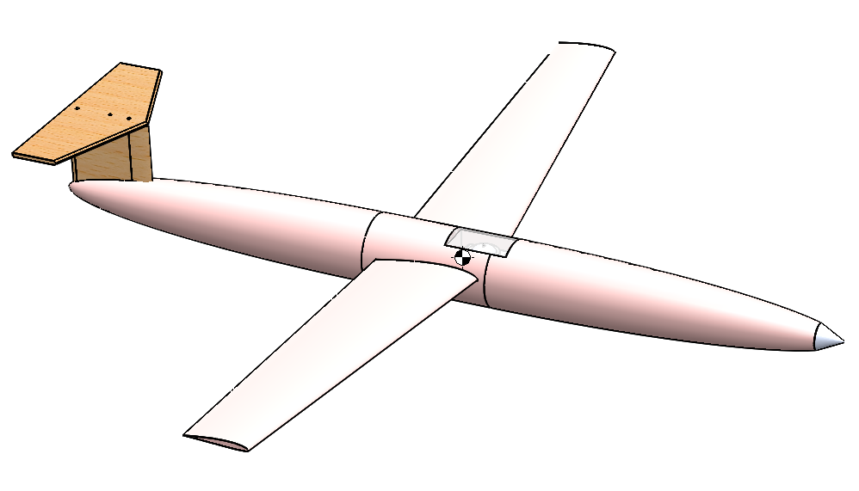
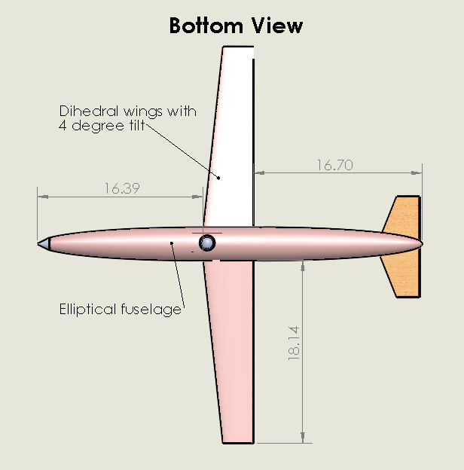
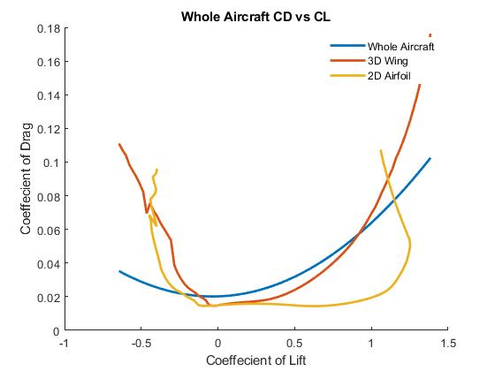
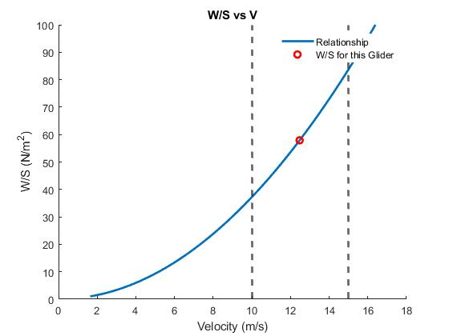
Design A
L/D Max: 16.57
AoA at L/D Max: 6.5°
W/S: 57.9 N/m^2
Glide Velocity: 12.47 m/s
Range: 116 m
Airfoil: SA 7035

Slide 3
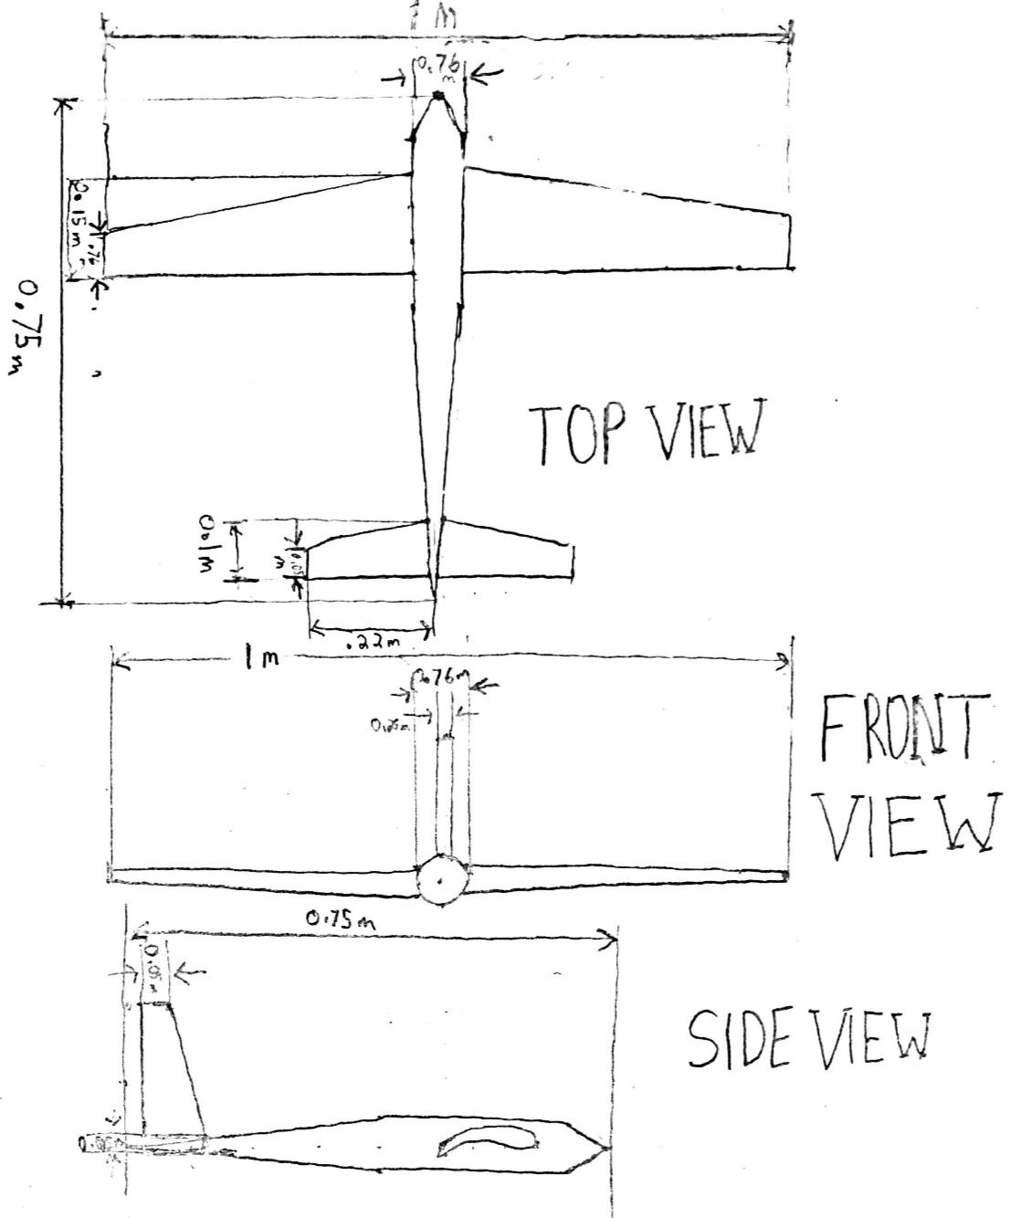
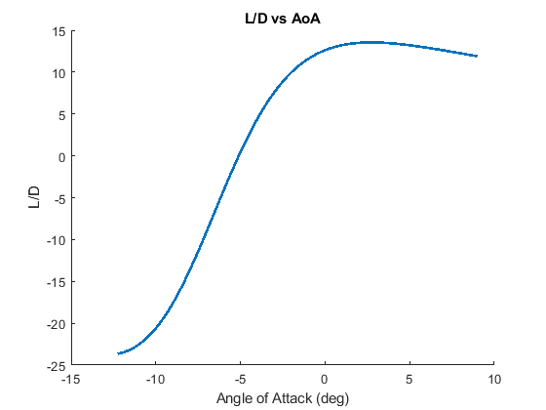
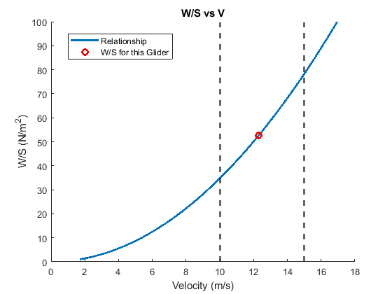
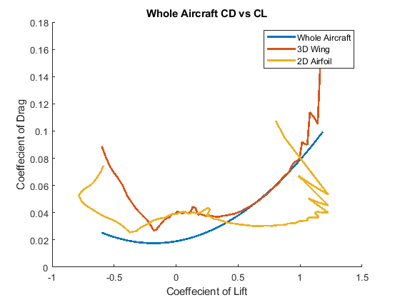
Design B
L/D Max: 13.54
AoA at L/D Max: 2.750°
W/S: 52.546 N/m^2
Glide Velocity: 12.289 m/s
Range: 94.846 m
Airfoil: Eppler 748 sailplane airfoil

Slide 4
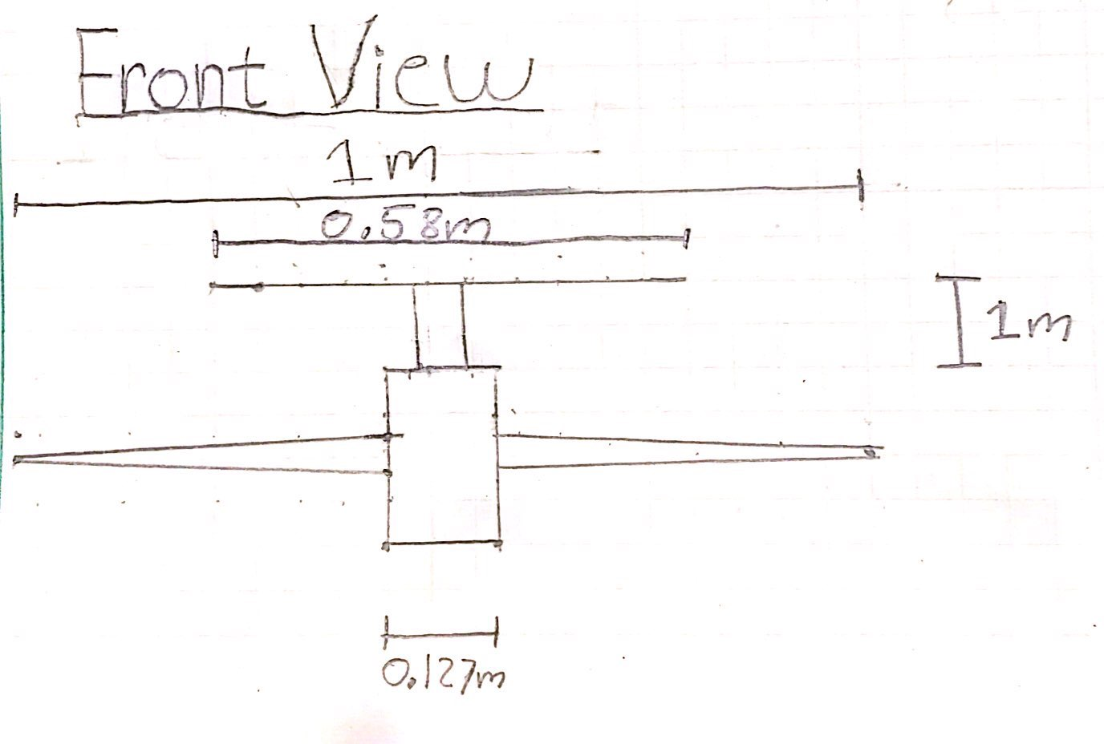
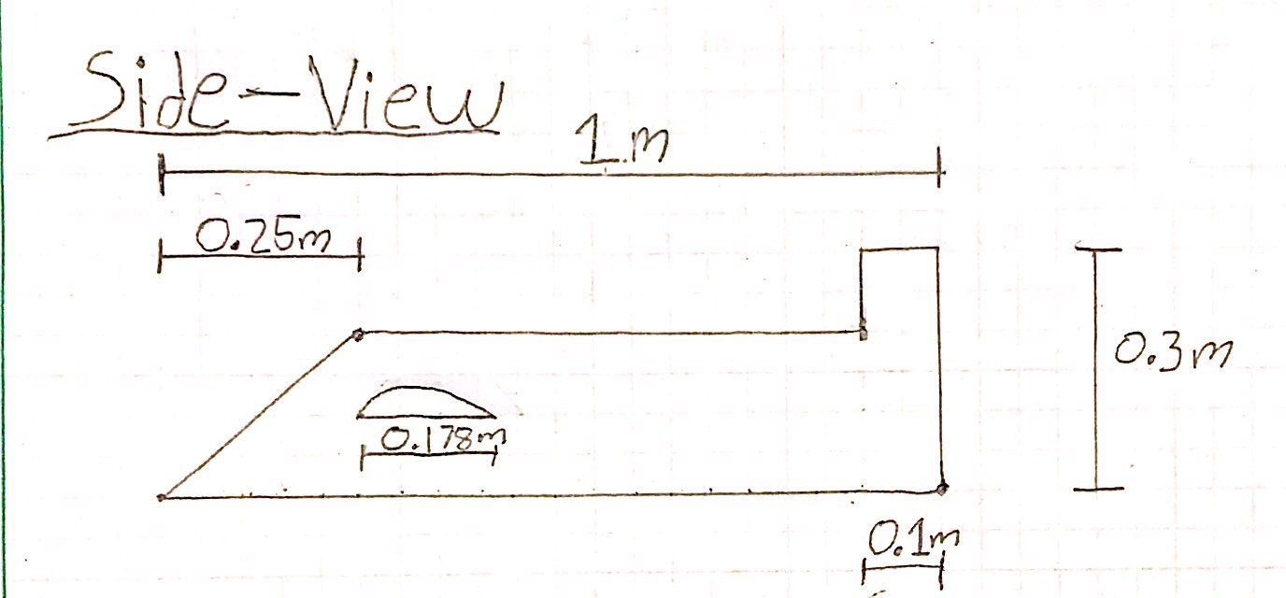
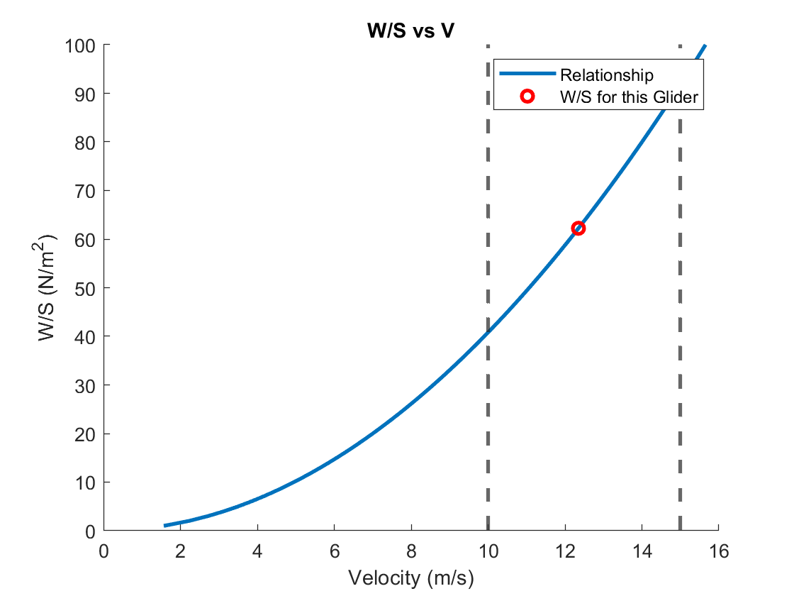
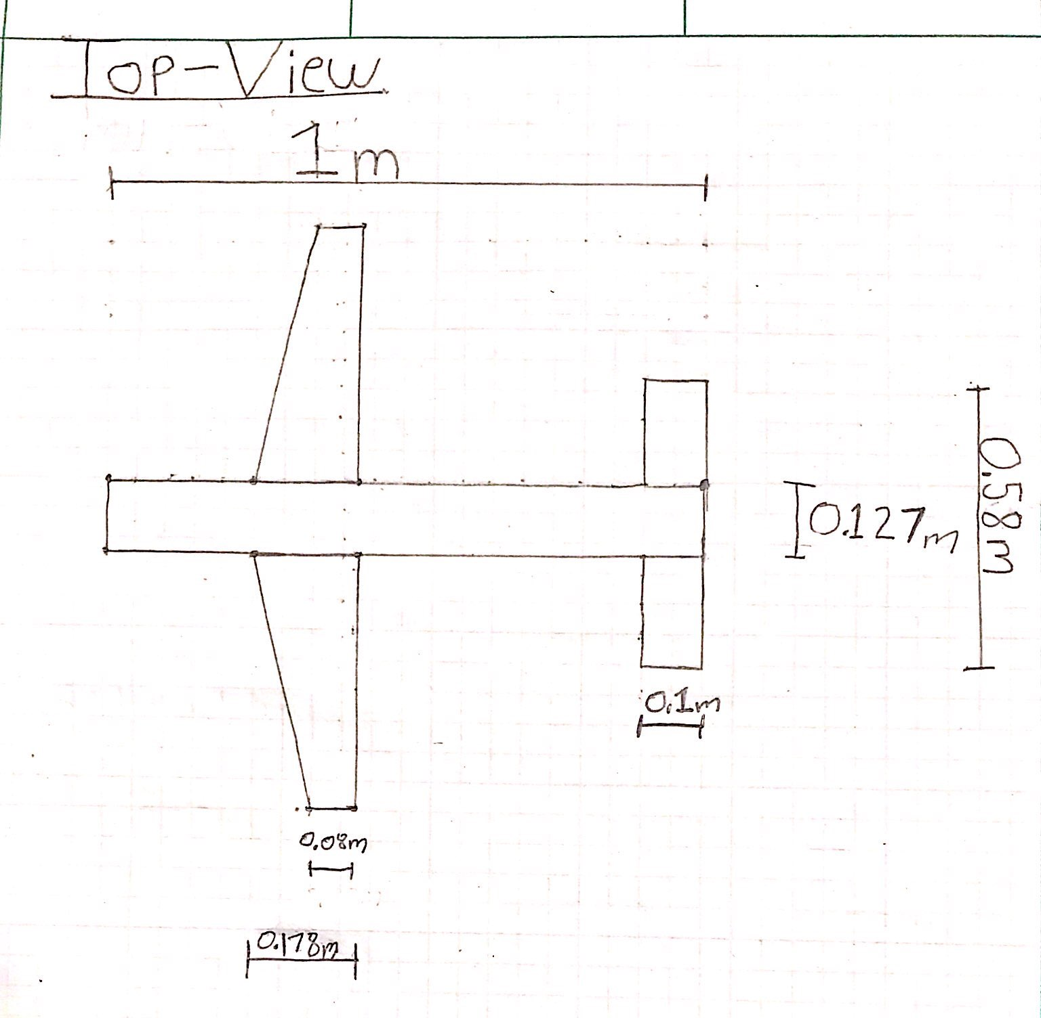
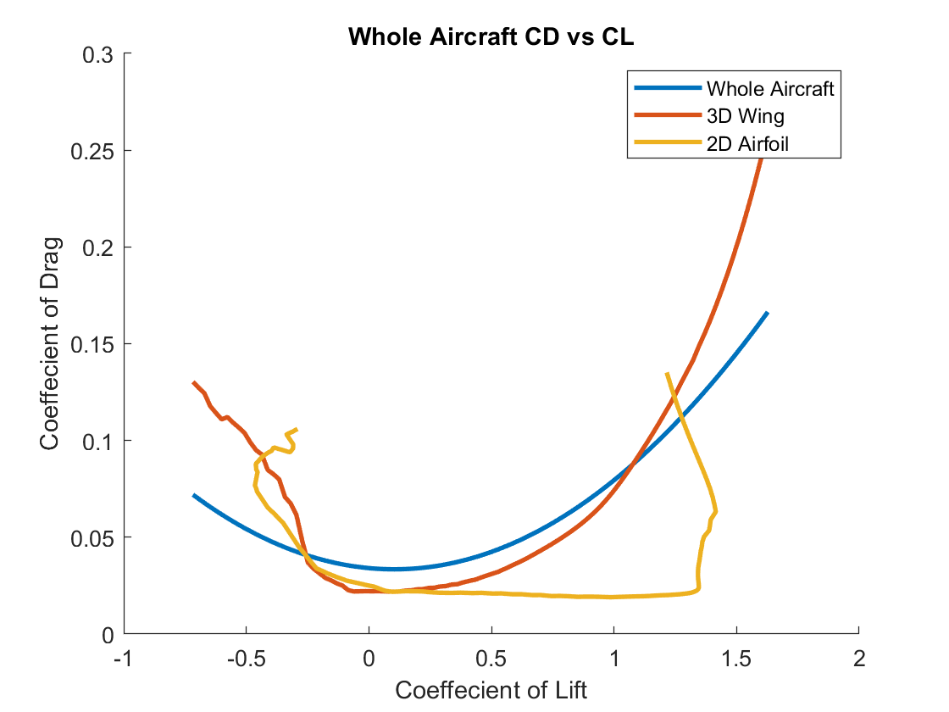
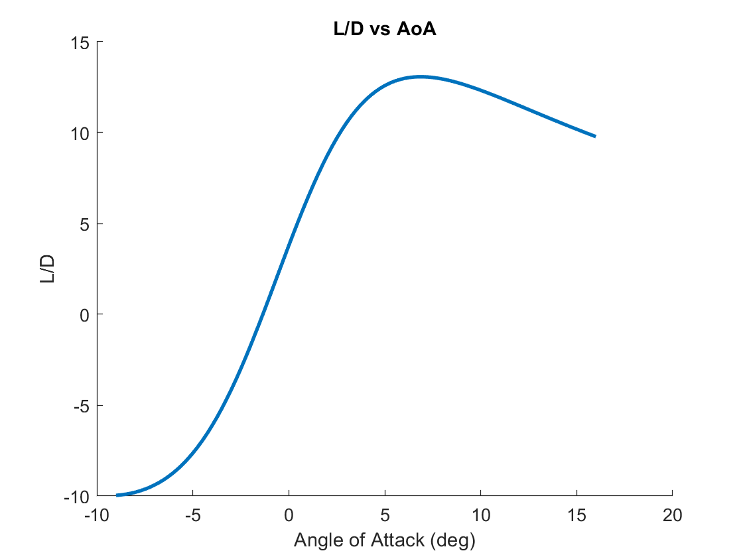
Design C
L/D Max: 13.07
AoA at L/D Max: 6.750°
W/S: 62.25 N/m^2
Glide Velocity: 12.35 m/s
Range: 91.5 m
Eppler E214

Slide 5
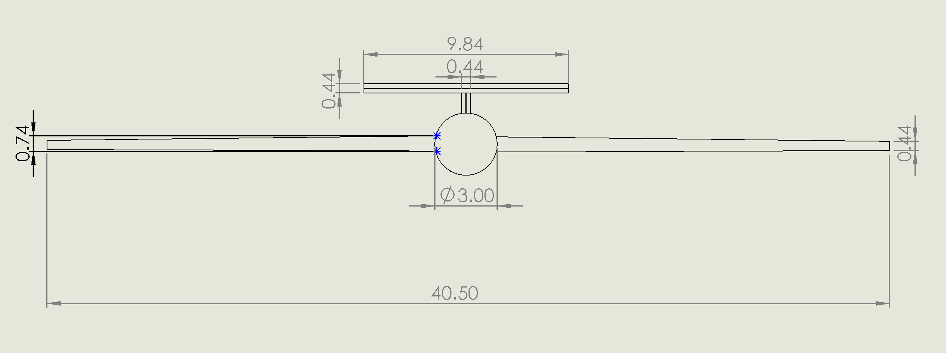
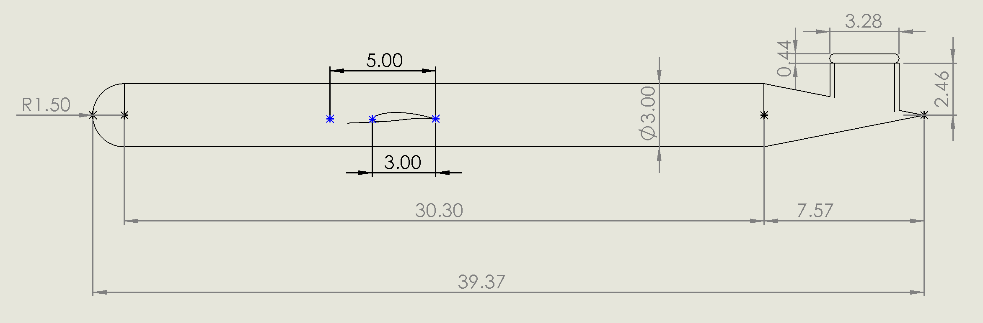
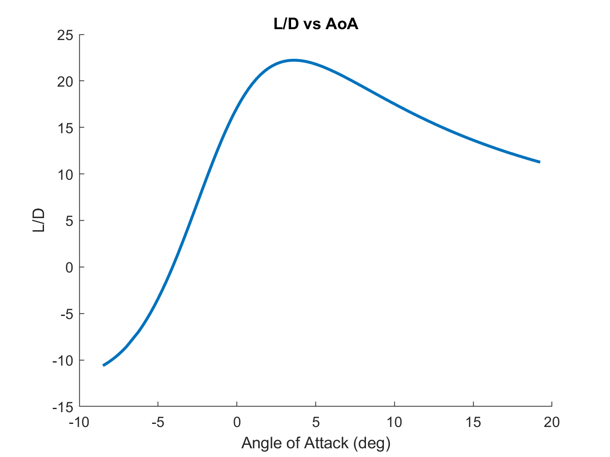
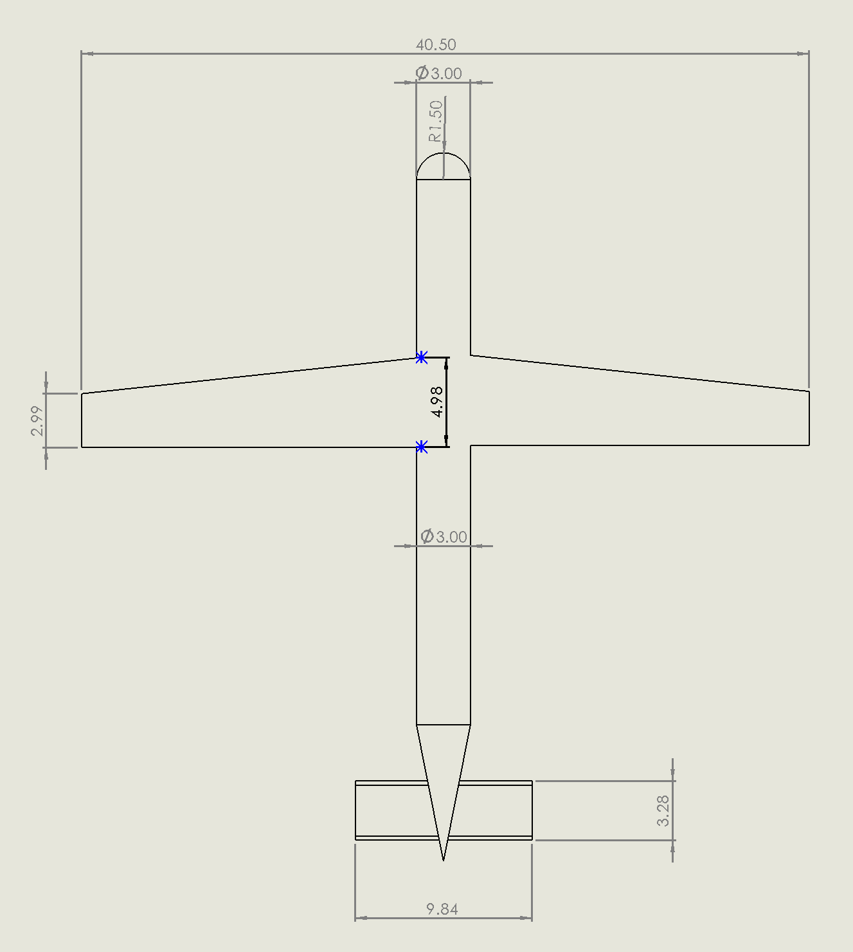
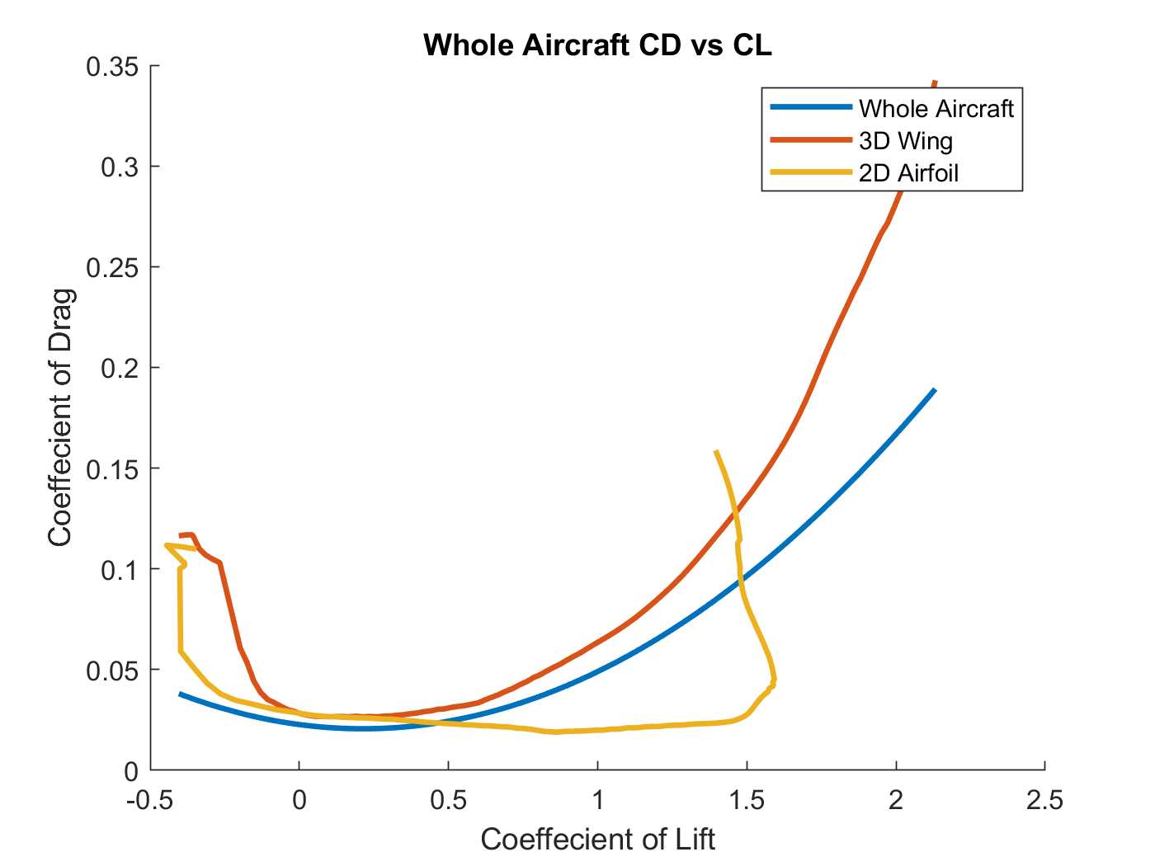
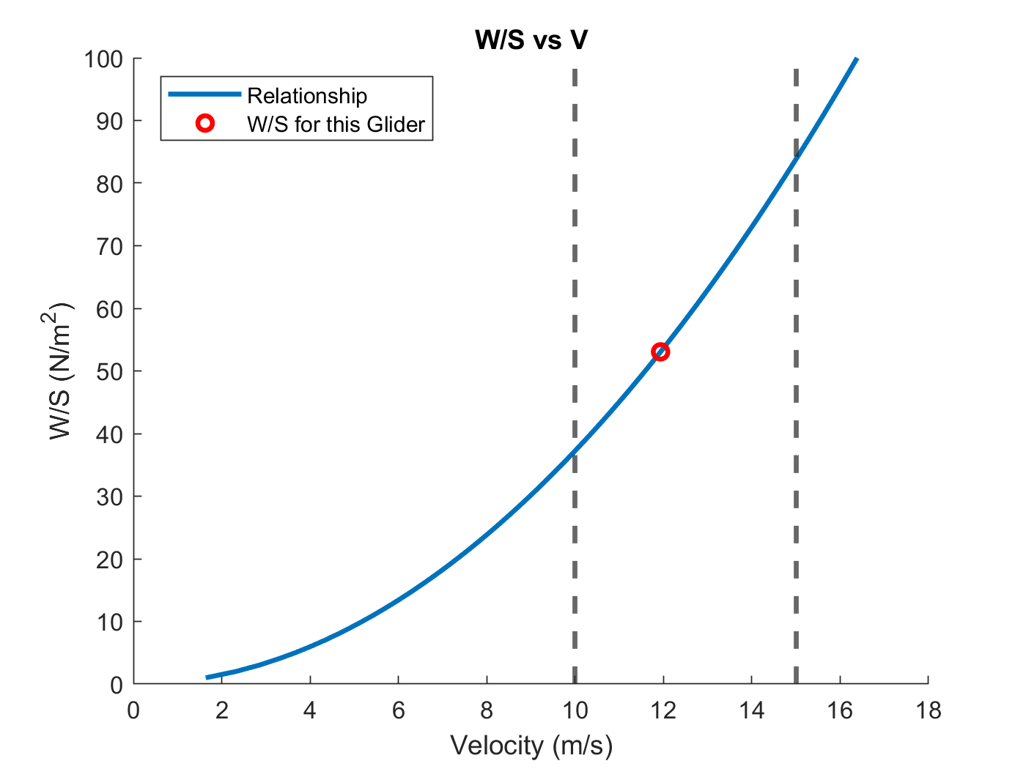
Design D
L/D Max: 22.22
AoA at L/D Max: 3.5°
W/S: 53.05 N/m^2
Glide Velocity: 12 m/s
Range: 155.53 m
Airfoil: GOE 430

Slide 6
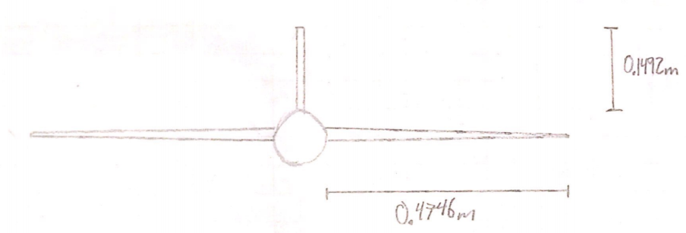
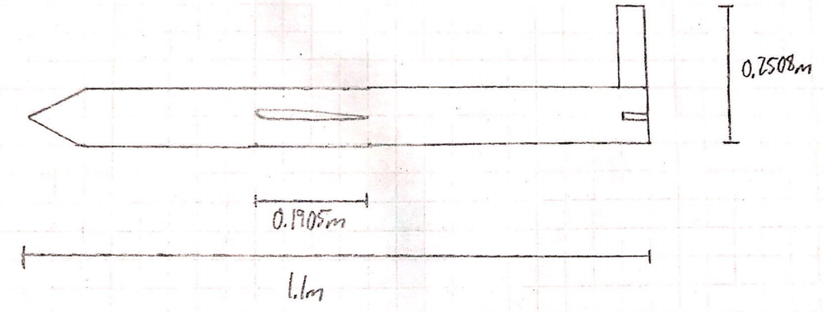
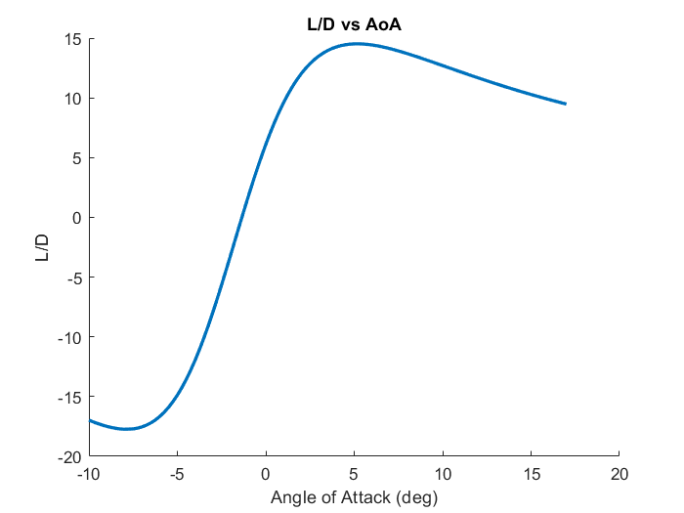
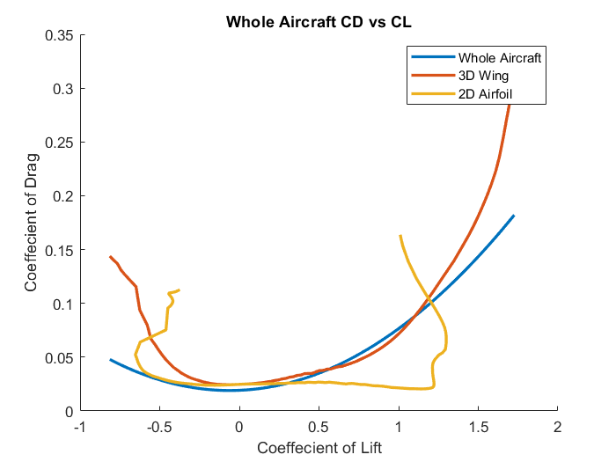
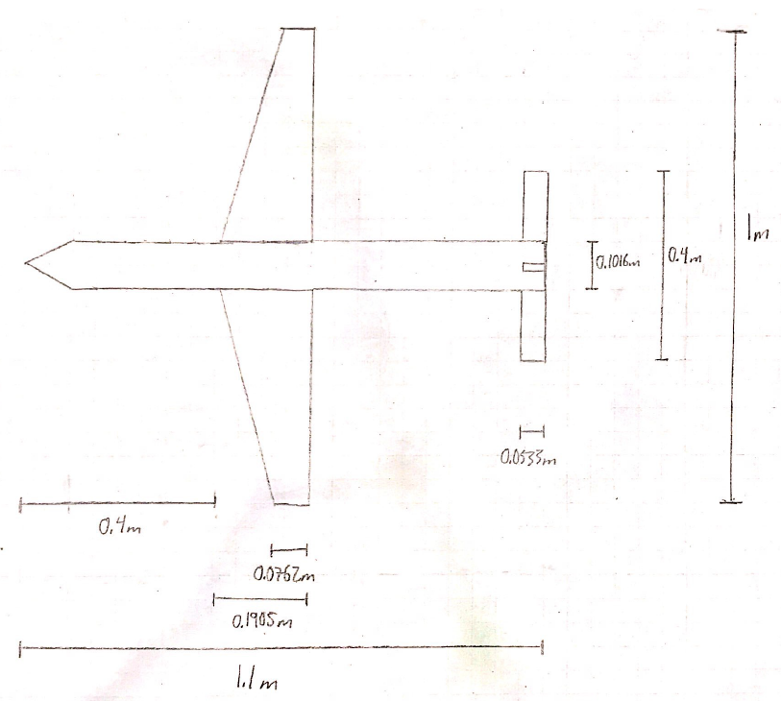
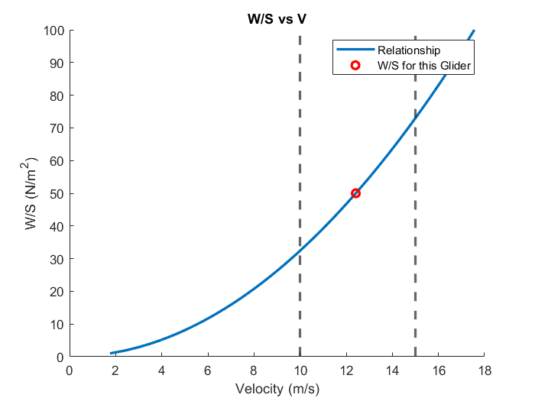
Design E
L/D Max: 14.521
AoA at L/D Max: 5.250 degrees
W/S: 49.994 N/m^2
Glide Velocity: 12.416 m/s
Range: 101.646 m
Eppler e68 Airfoil

Slide 7
Down Selection
Design | Weight (N) | W/S (N/m^2) | Glide Velocity (m/s) | Max Range (m) | L/D Max | AoA at L/D Max (deg) | Manufacturing Difficulty | Rankings and Total Score
A | 5.88 | 57.9 | 12.5 | 116 | 16.6 | 6.5° | Hard | 1412243 = 17
B | 5.9 | 52.5 | 12.3 | 94.8 | 13.54 | 2.75° | Medium | 2244412 = 19
C | 8.3 | 62.3 | 12.4 | 91.5 | 13.1 | 6.75° | Easy | 5525551 = 28
D | 6.06 | 53.05 | 12 | 155 | 22.2 | 3.5° | Medium | 3351122 = 17
E | 6.67 | 50 | 12.4 | 102 | 14.5 | 5.25° | Easy | 4123331 = 17

Slide 8
Chosen Design - Design D
Risks:
Performance
Lower glide velocity, 12 m/s
Underestimated drag polar, glider may underperform
Construction
Thin airfoil
13.7% thickness at max chord, very thin at trailing edge
Conical and Hemispherical shape
Hard to manufacture
Cone offers little support for tail surfaces
Further Optimization:
Wingtips
Reduce induced drag
Add weight
Unsure how to analyze
Dihedral Wings
Improvement on roll stability
Increase ballast
Raises glide velocity
Carbon fiber
Increase in strength, removes need for a ballast, experienced in composites
May change COM

Slide 9
References
Phillips, WF, Minimizing Induced Drag with Geometric and Aerodynamic Twist, CFD Validation,
Utah State University, AIAA (2005). https://arc-aiaa-org.colorado.idm.oclc.org/doi/pdf/10.2514/6.2005-1034
Kentfield, JAC, Fuselage-Wing Interference Drag Of Aircraft With Relatively Short Pod-Type Fuselages,
University of Calgary, AIAA (2002). https://arc-aiaa-org.colorado.idm.oclc.org/doi/10.2514/6.2002-708
Chen, T.M, Katz, J, Induced Drag of High-Aspect Ratio Wings,
SDSU, AIAA (2004). https://arc-aiaa-org.colorado.idm.oclc.org/doi/pdf/10.2514/6.2004-38

Slide 10
BACKUP SLIDES

Slide 11
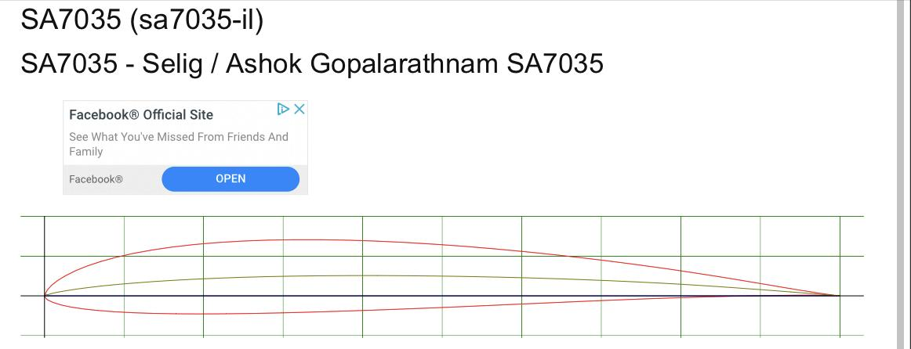
Glider A - SA 7035

Slide 12
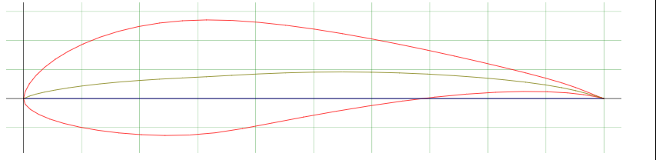
Glider B - EPPLER 748 AIRFOIL (e748-il) sailplane

Slide 13
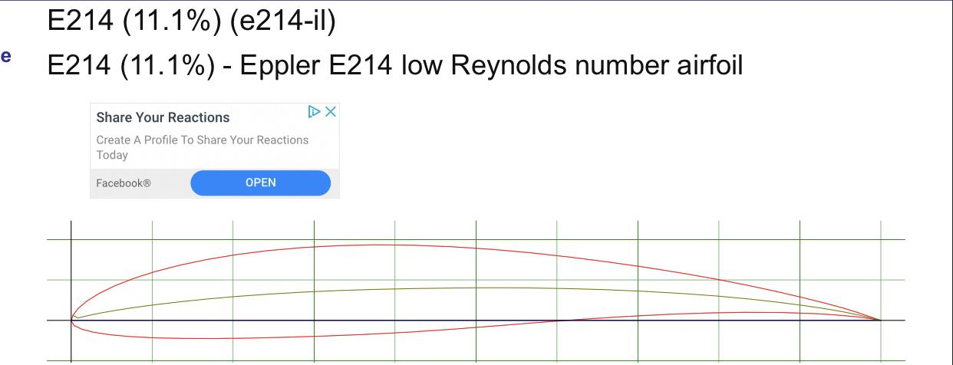
Glider C - Eppler E214

Slide 14
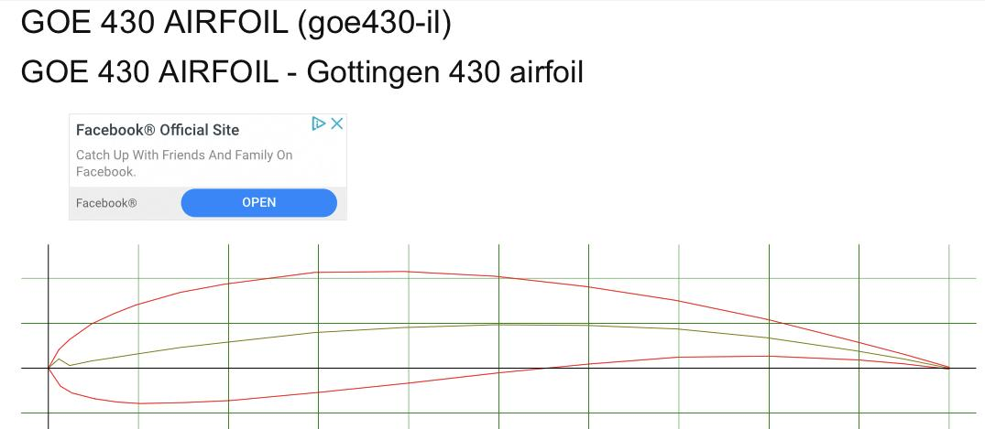
Glider D - GOE 430

Slide 15
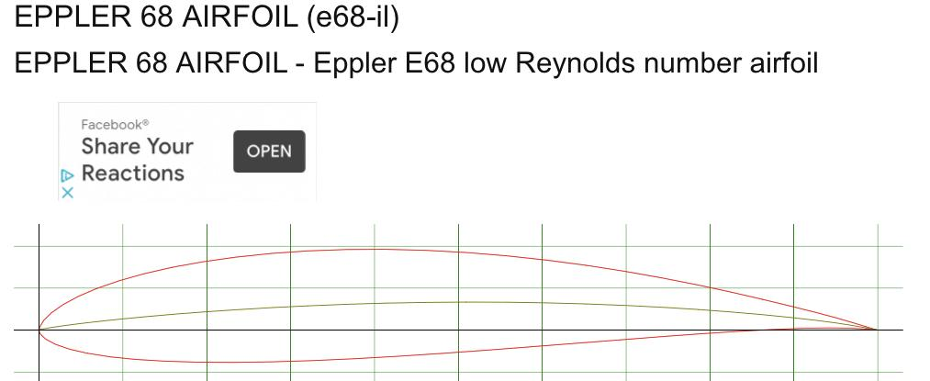
Glider E - Eppler e68

